Slide 1
Kaiser Permanente
Managing Product Development
Product Manager: Diana Vile
© 2019 Udacity. All rights reserved.

Slide 2
Updated PRD & Prototype
© 2019 Udacity. All rights reserved.
Notes:
[ALL PARTICIPATION]

Slide 3
Kaiser Permanente
Kaiser Permanente is looking to enter into the preventative care space to help their patient base increase physical activity and improve on healthy habits. While the overall goal is improved patient satisfaction and well being, the specific financial goal is reduced cost by emphasizing improved health prior to any adverse conditions developing. Overall, KP wants to decrease spending on conditions such as type 2 diabetes
Project- HealthY

Slide 4
Updated PRD
Kaiser Permanente Project Kaiser Permanente is looking to enter the preventative care space to help its patient base increase physical activity and improve healthy habits. While the overall goal is improved patient satisfaction and well-being, the specific financial goal is reduced cost by emphasizing improved health before any adverse conditions develop. Overall, Kaiser Permanente wants to decrease spending on conditions such as type 2 diabetes.
Background
In the United States (US), 6 in 10 adults live with a chronic disease, and 4 in 10 adults have more than one. Potential causes include poor nutrition (90%), lack of physical activity (50%), excessive alcohol use (20%), and extensive tobacco use and exposure to second-hand smoke (25%). A combination of these potential causes often leads to chronic diseases. Moreover, every 2/3 in 10 premature deaths of adults (20-30%) could be prevented by conducting physical activities. 90% of these costs could be saved with preventive healthcare.
The US spent $4.1 Trillion in Annual Health Care Costs on chronic disability such as diabetes, depression, high blood pressure and heart diseases care and premature death". Take Diabetes. In 2022, 133 million Americans (both children and adults) were diagnosticated Diabetes (37M) and Pre-Diabetes type 2 diabetes (96M). That year, $327 billion is spent on treating diabetes, a chronic disease related to lack of physical activity and poor nutrition. In addition, $117 billion is spent annually on treating diseases related to insufficient physical activity and $173 billion related to poor nutrition.
Diabetes healthcare costs in total (adults & children): $327 billion.
Adults with Diabetes: 77.8% (adults) * 133 million Americans (total population): 103.474 M Adults with Diabetes.
Preventable Diabetes healthcare costs for Adults: $327 billion/103.474 M Adults with Diabetes= 3,160.21416B * 90% = 2,844.19274 billion.

Slide 5
Updated PRD (page 2)
Problem
Chronic diseases such as Diabetes and Pre-Diabetes (Diabetes type 2) not only affect people’s health, it also affects their productivity at work, due to frequent medical and hospital visits with a calculated $2.8 Billion of unnecessary healthcare costs if preventive healthcare is taken more seriously.
As a result, Kaiser Permanente aims to reduce expenses on preventable diseases, such as Diabetes and Diabetes type 2 (Pre-Diabetes), increase health awareness and promote fitness and physical activity as a healthcare provider. Therefore, Kaiser Permanente is currently partnering with health-related businesses and technology partners to create tailored health initiative programs for the existing Kaiser Permanente App on mobile devices Ios and Android. These digital modules in the form of Paid Subscription to the existing free Kaiser Permanente App are:
Module 0: Healthy tips from Health pros.
Module 1: Sports & Nutrition.
Module 2: Self-care (future build).
Consequently, we propose a Paid Subscription add-on Module to the existing application to promote physical activities and improve customers’ nutrition. Assuming 5% of the 12.6M Kaiser Permanente members will subscribe and benefit from it in the first year. In the second year, we focus on attracting more customers to subscribe and increasing our member base and creating the second module Self-care.

Slide 6
Updated PRD (page 3)
Goals
First-year:
● Build an application that encourages customers to perform physical activities and manage their nutrition.
● Provide personalized training and nutrition programs to paid subscribers.
● Decrease diseases associated with lack of physical activities.
Second year:
● Increase the number of subscribers’ base.
● Improve patient satisfaction and well-being.
● Reduce annual health costs.

Slide 7
Updated PRD (page 4)
Success Metrics
● 5% of current members (12.6M) use the subscription model.
● 30% of current members (12.6M) download the Application.
● 50% of application users with Paid Subscription module reduced the infection of chronic diseases.

Slide 8
Updated PRD (page 5)
For Phase 1 of the HealthY Paid Add-on modules for the Kaiser Permanente app, we will focus on building the basic functionality (Module 0), not including Fitness & Nutrition (Module 1, phase 2) or Self-care (Module 2, phase 3):
Priority level:
P0 = launch blocker. The product will not launch without this feature.
P1 = desirable for launch, but not required. Will follow after launch.
P2 = nice to have.
P3, P4 = unlikely to get built.

Slide 9
Updated PRD (page 6)
Key Features & Scope Handoff [What are we building? What are we explicitly not building?]
Prioritization | Feature | Description
P0 | Register to HealthY | The User will be asked to register for the (paid) app. User-sensitive data such as name, Health ID-number and email address will be asked consent for.
P0 | Log in to HealthY | After registration, the user will be asked to login to the (paid) app.
P2 | Create a profile | Upon Registration, the user will be able to create and edit their profile.
P0 | Create a HealthY Goal | The user will be able to choose different HealthY Roadmaps to start to improve his health one step at the time. Goals are predetermined and follow a fixed path.
P1 | Create a health Test | Each main goal start with a health test.
P3 | Get Health Test Results | At the end of each health test, the results will be available inside the app and/or sent to an email address. This will help the user to know how his health is and how it can be improved.

Slide 10

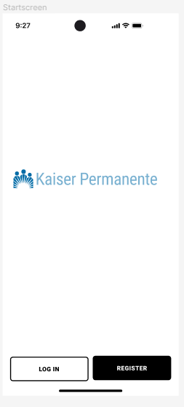
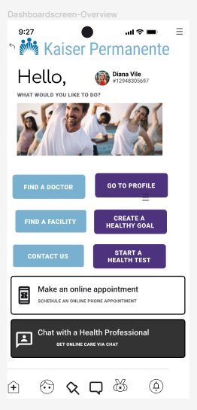
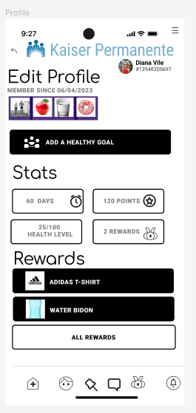
Updated PRD (page 7)
Note: This is not a complete PRD. It only includes the relevant section for this project, which is feature requirements.
Prototype V2
Core UX Flow
Handoff: Link to mocks
Iteration 1:
V1- Design- HealthY
V1- Prototype- HealthY
Iteration 2:
V2- Design- HealthY
V2- Prototype- HealthY

Slide 11
Test Plan
Create a test plan to validate everything is built to spec and working correctly
© 2019 Udacity. All rights reserved.
Notes:
[ALL PARTICIPATION]

Slide 12
Test Plan:
Priority
P0 (1)
P0 (2)
P0 (3)
P1 (4)
Features
1 Register HealthY
2 Login to HealthY
3 Create a health Goals
4 Create a Health Test
Scope
Registration
Payment & Login
Log health goals (max 12)
Health Test
Objectives
User can register for Premium subscription (paid add-on HealthY)
User can login to Premium subscription (paid add-on HealthY)
User can create a health Goal in HealthY app. (Max 12.)
Users can do the Health Test.

Slide 13
Test Cases: Functional Requirements
Priority
P0 (1)
P0 (2)
P0 (3)
P1 (4)
Key Feature 1: REGISTER | Steps (to trigger feature) | Expected Behavior
Test Case 1: The user can register for HealthY, the paid Add-on Module for the Kaiser Permanente App. | Load application logo. Show start screen login/register. Choose the register button. Show a registration page. Show a Save button (save data to cloud). | User-sensitive information (email address and password) is stored in the cloud in < 10 sec.
Test Case 1-1: The user can use their credit card during the checkout flow. | Show payment options at the register. Select a credit card. Fill in details. Choose the option “14 days for free”. Show “payment renews automatically each month after the trial period unless you unsubscribe before”. | Storage payment data of users in the cloud via encrypted data in < 20 sec.
Test Case 1-3: The system sends a notification of registration to the user. | Send email notification of registration link to user e-mail with login details. | The system sends a register notification to the user’s email in 1 minute.
Test Case 1-4: The user will receive an e-mail reminder, 3 days before the end of the trial period. | 3 days before the expiry of the trial period, send an automated email to the customer. Day of renewal, if cancelled, send thank you email and deactivate access to Paid account. Day of renewal, if not cancelled, take money from the credit card for next month. Send an email to customer to inform month is paid. | The store can process 20,000 credit card transactions at any given time in < 5 minutes.

Slide 14
Test Cases: Functional Requirements
Priority
P0 (1)
P0/1 (2)
P0 (3)
P1 (4)
Key Feature 2: LOGIN | Steps | Expected Behavior
Test Case 2: The user can log in to Kaiser Permanent App, Healthy, after registering. | Load application logo. Show start screen login/register. Choose the login button. Show a login page. If paid> fill in login details. If NOT paid after trial> redirect to the payment page. | User-sensitive information (email address and password) is being stored in the cloud in < 10 sec.
IF NOT PAID after trial Test Case 2-1: The user can use their credit card during the checkout flow to pay for the Paid Add-on Modules. Might not be needed, as the user interview suggested. Available in Apple or Google Store. | Show payment notification on login. Select a credit card Fill in details. Choose the option “14 days for free”. Show “payment will be renewed automatically each month after the trial period unless you unsubscribe before”. | The user will receive an email with login details & link 1 minute after payment.
Test Case 2-2: The user can choose a password to login. | If paid, the user can fill in login details. Once logged in, the main screen with goals is shown. | The system sends a Notification in < 30 sec.
Test Case 2-3: The user can change password. | The user selects Forgot Password. An email is sent to the user. The user clicks on the link in the user to reset the password. | - The system sends a “change password email + link” in 1min. - Automatic confirmation of password changes is sent.

Slide 15
Test Cases: Functional Requirements
Priority
P0 (1)
P1 (2)
Key Feature 3: Health Goal | Steps | Expected Behavior
Test Case 3: The user can create a health goal. | User clicks on the black + button below to add a health goal. User clicks on the white button Health Goal above to log a new health goal. | The system stores the log of the Health Goal of the customer in the cloud < 5 sec.
Test Case 3-1: The user can select a health goal in main Goals screen. | The User selects the health goal from the Main Goals screen. Health Goal opens. Short description of Goal details. HealthY Roadmap Health Goal is showing. Customer starts with step 1, Health Test. | The system opens the selected health goal on the health goal page < 5 sec. The system shows the HealthY Roadmap of the health Goal < 5 sec.

Slide 16
Test Cases: Functional Requirements
Priority
P0 (1)
P3 (2)
Key Feature 4: Health Test | Steps | Expected Behavior
Test Case 4: The user can start with step 1 of Health Roadmap for a given health goal- The health test. | User clicks on Health Roadmap of given health goal. User clicks on Next. User starts with Health Test. | The system stores the log of the Health Test answers of the customer in the cloud in < 10 sec.
Test Case 4-1: The user can view the results of the Health Test. Not for this DESIGN SPRINT, postponed for the next one. | The User finished the Health Test. Health Goal opens. Short description of Goal details. HealthY Roadmap Health Goal is showing. Customer starts with step 1, Health Test. | Notification is sent per email to the customer, about Health Test results in 1 minute.

Slide 17
Test Cases: Non-functional Requirements
Priority
P0 (1)
P0 (2)
P0 (3)
Requirement | Steps to reproduce
Test Case 1: Registrar | Store User-sensitive information (email address and password) in the cloud in < 10 sec. Store User-sensitive payment data (credit card details) encrypted in the cloud in < 20 sec. Send register notification to user’s email in 1 minute. Process 20.000 credit card transactions at any given time in < 5 minutes.
Test Case 2: Login | Store User-sensitive information (email address and password) in the cloud < 10 sec. Store User-sensitive payment data (credit card details) encrypted in the cloud < 20 sec. Send a register notification to the user’s email with login details & link 1 minute after payment. Send “change password email+ link” in <30 sec. Send an automatic confirmation notification of the password is changed in 1min.
Test Case 3: Health Goal | The system stores the log of the Health Goal of the customer in the cloud < 5 sec. The system opens the selected Health Gaol on the Health Goal screen < 5 sec. The system shows the HealthY Roadmap of the Health Goal < 5 sec.

Slide 18
Dogfood Survey
Create a dogfood survey to get insight from real-world usage
© 2019 Udacity. All rights reserved.
Notes:
[ALL PARTICIPATION]

Slide 19

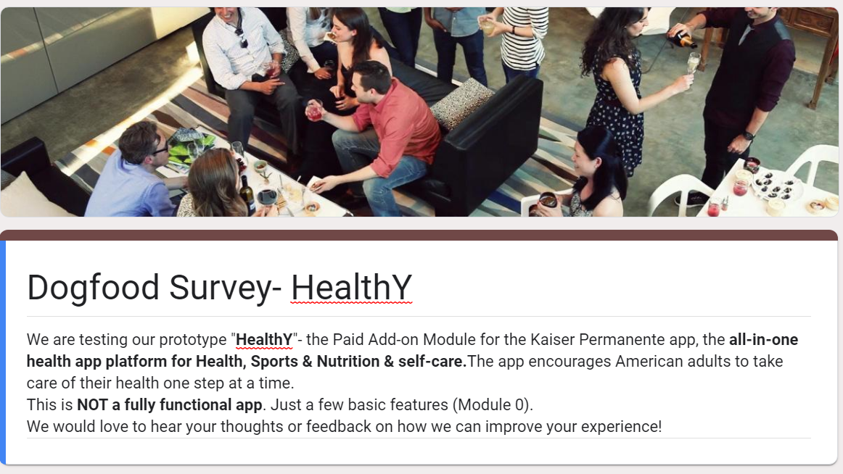
Dogfood Survey
https://docs.google.com/forms/d/1HSTJE24ukFJRpMx14hTNsR3ABlK04ovDmTtfZr9-hj8/prefill
1-Dogfood Survey -Introduction Header
Dogfood Survey Link

Slide 20
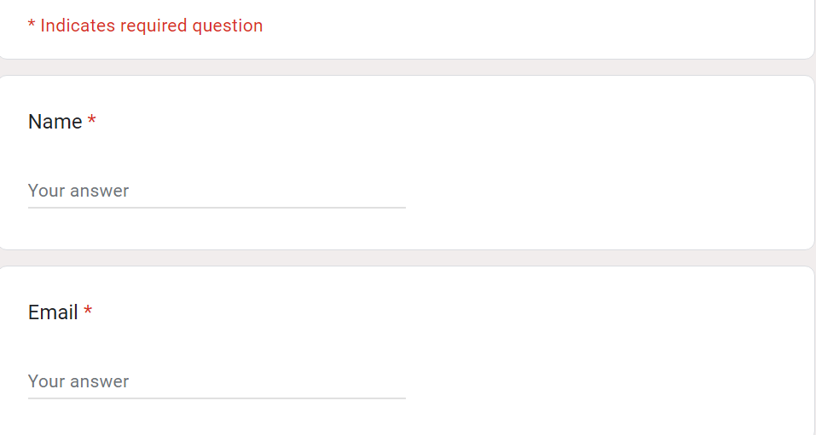
Dogfood Survey
2-Contact details
Dogfood Survey Link

Slide 21
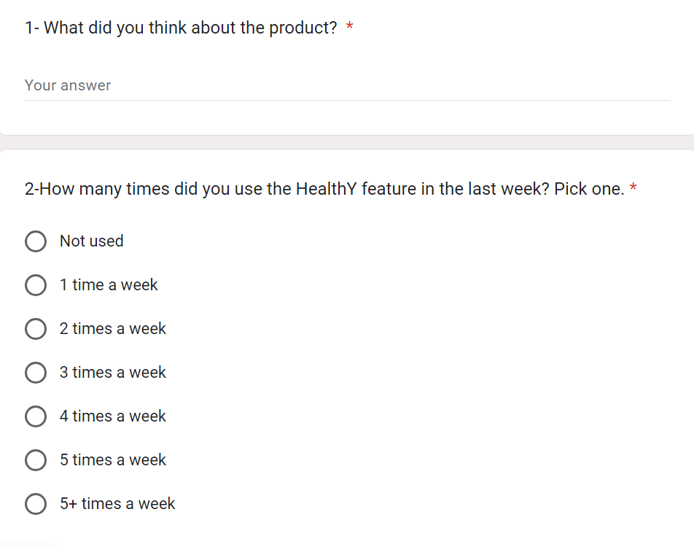
Dogfood Survey
3-Question 1-2
Dogfood Survey Link

Slide 22
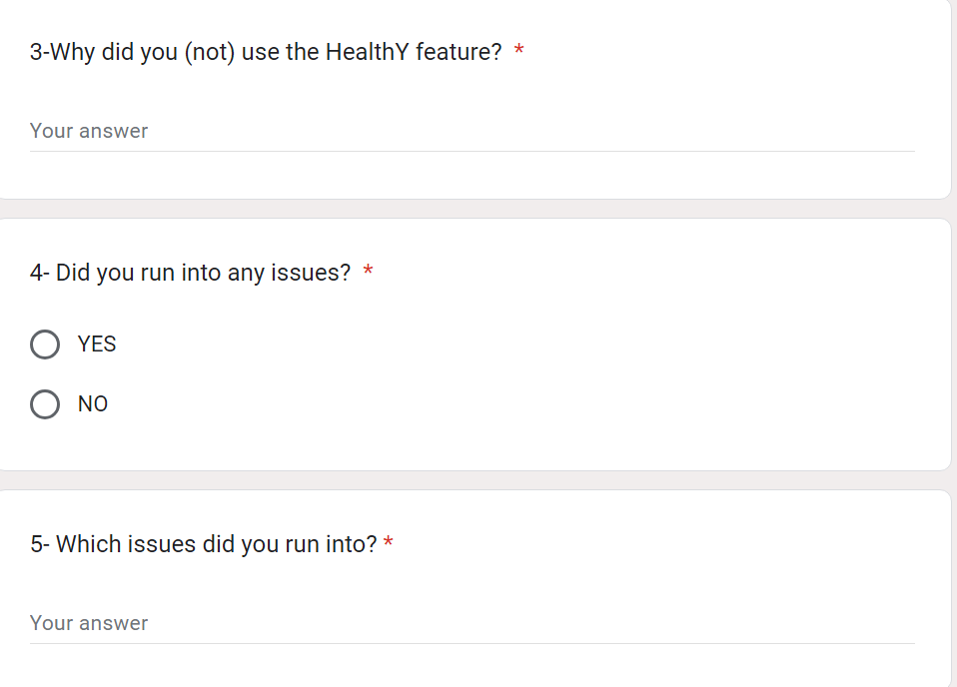
Dogfood Survey
4-Question 3-5
Dogfood Survey Link

Slide 23
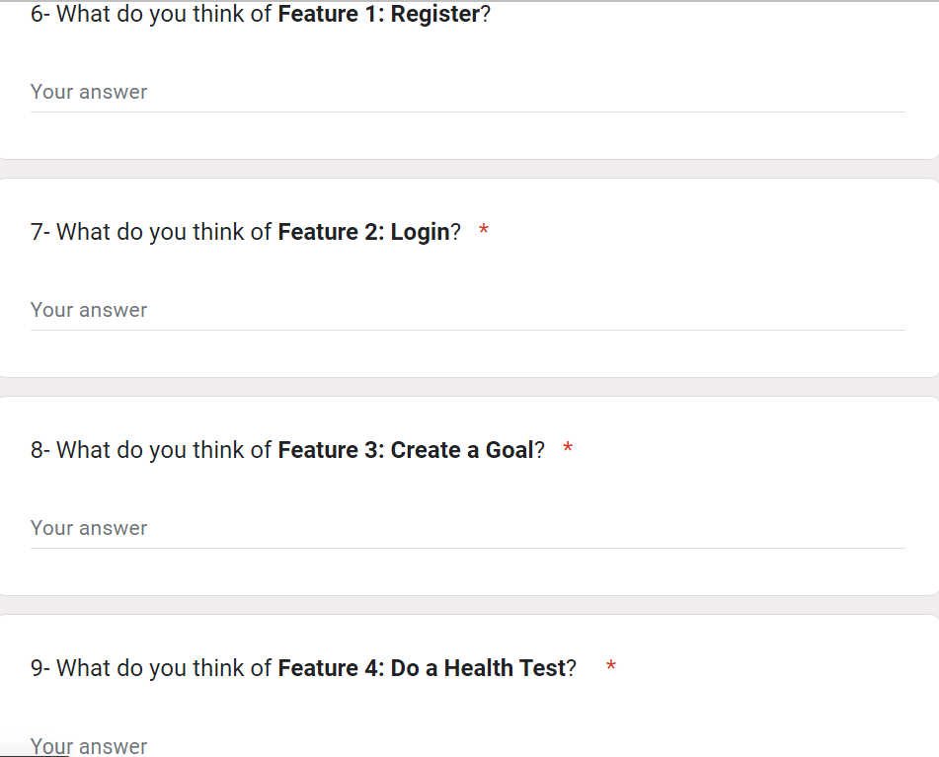
Dogfood Survey
5-Question 6-9
Dogfood Survey Link

Slide 24
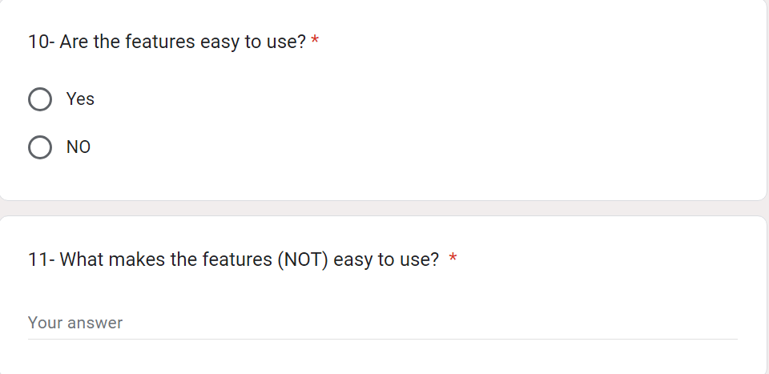
Dogfood Survey
6-Question 10-11
Dogfood Survey Link

Slide 25
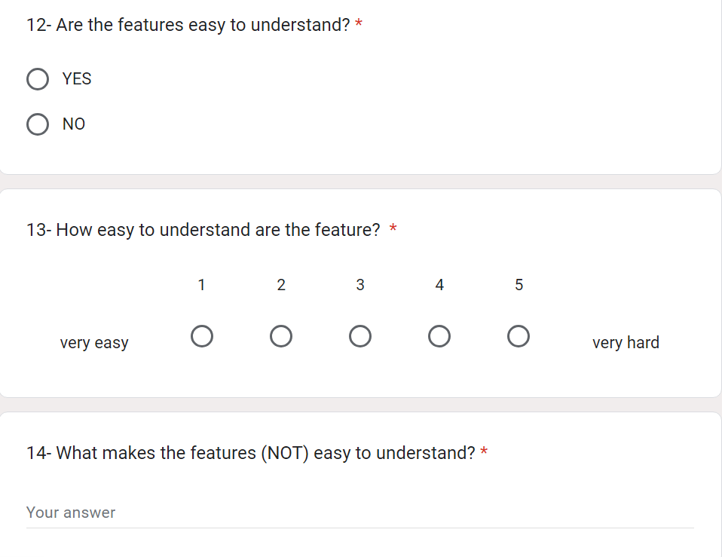
Dogfood Survey
7-Question 12-14
Dogfood Survey Link

Slide 26
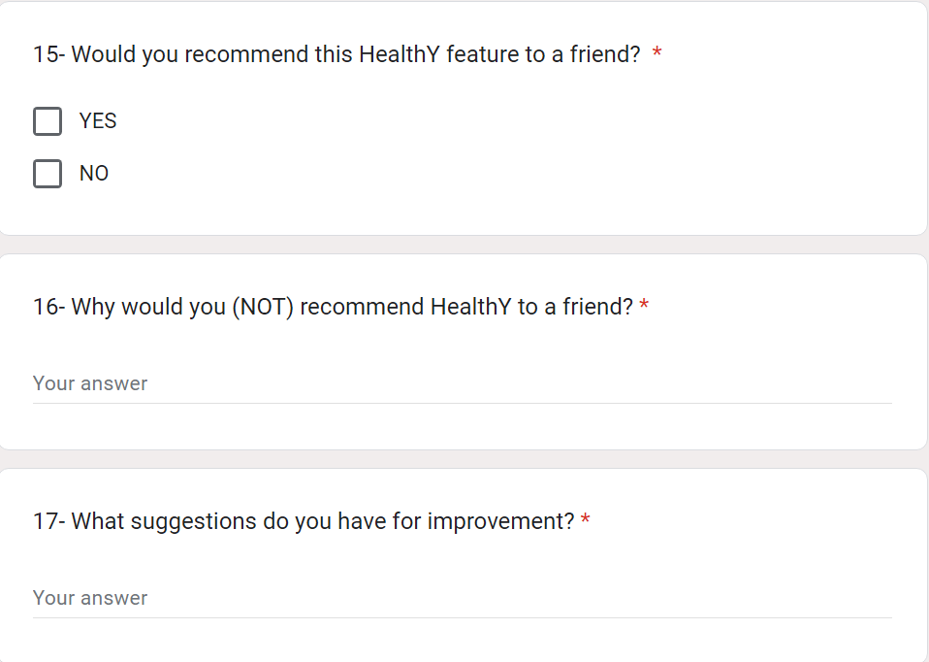
Dogfood Survey
8-Question 15-17
Dogfood Survey Link

Slide 27
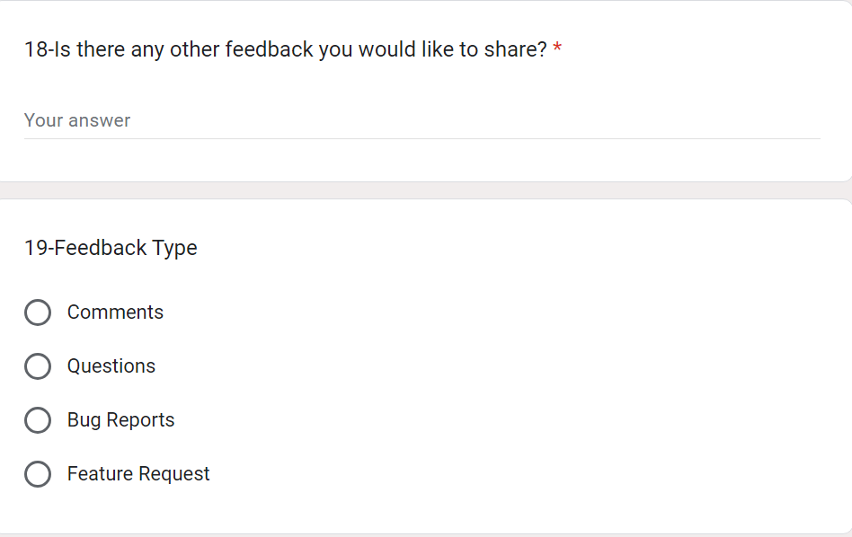
Dogfood Survey
9-Question 18-19
Dogfood Survey Link

Slide 28
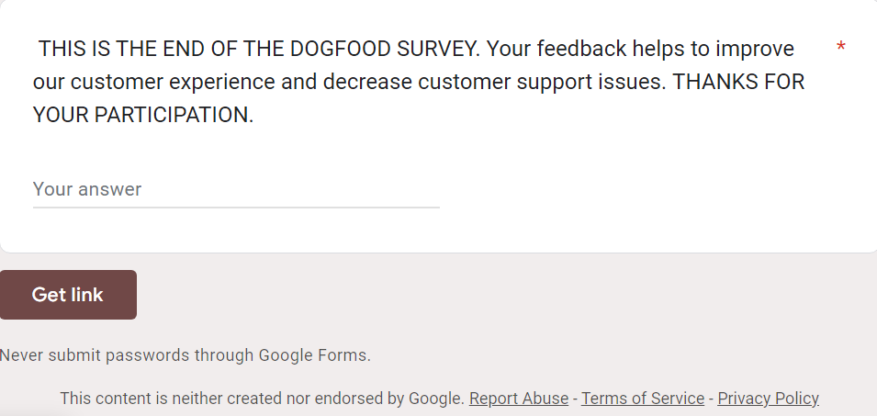
Dogfood Survey
10-Final words
Dogfood Survey Link

Slide 29
Fire Drills & Prioritization
Issues come up. Keep the team focused on the things that matter the most
Notes:
[ALL PARTICIPATION]

Slide 30


Team
These are the people on your team.
Leadership team
Product team
Tech Lead
UX Lead
Support Lead
Marketing Lead
Lawyer
Engineers
QA Team
Designer
Researcher

Slide 31
Fire Drills
Scenario | Who | Communication Method | Key Messages
QA finished testing and reported that 3 test cases failed | QA Team, Tech Lead, Leadership Team, | EMAIL | We need to investigate why the test cases failed and prolong the launch date until the issues are solved.
An engineer is ready to start working on the next feature, but doesn’t have the mocks for it | UX Lead, Engineers, QA Team. | PING | First things first. Let’s first improve the existing features, before creating new ones. When all test cases are ok, we can implement new features.
Support flagged that many users are unable to sign in to their accounts | Tech Lead, UX lead, Support Lead. | MEETING | Customer Support informs about issues with sign in. Engineering, please investigate the sign in feature. Is this related to a security Failure?
Dogfood survey results are in and dogfooders are not excited about recommending the product | Product Team, UX Lead, Tech Lead | MEETING | Why are dog fooders not excited? What is missing for them to recommend the product? This outcome must be seriously improved before launch.
Legal informed you about a new law going into effect that will require you to add new privacy controls before you can launch | The new PM, PO (product owner) and Engineers. | DOC | We cannot launch any phase of the app, without having a full 100% ok from the Legal department. This is priority.
A new PM just joined your team and is interested in learning about your work | The old PM & the new PM, Product Team, PO. | MEETING | Let’s discuss together how to improve our product, before advising the engineering and design team to make improvements.

Slide 32
Prioritization
Scenario | Priority Ranked | Rationale
QA finished testing and reported that 3 test cases failed | PO (1) | As the +1 test cases failed, our engineers need to investigate the errors and refactor the code before launch.
An engineer is ready to start working on the next feature, but doesn’t have the mocks for it | P3 (6) | Before creating new features, it is important to improve the existing ones, so they pass the QA test.
Support flagged that many users are unable to sign in to their accounts | P0 (2) | As this is creating issues, our engineers need to investigate the case and troubleshoot the sign-in errors. This might be due to a security failure.
Dogfood survey results are in and dogfooders are not excited about recommending the product | P0 (4) | This is an important thing to investigate. Why are dog fooders not excited? What is missing for them in order to be able to recommend the product? The outcome of this must be taken seriously and improved before launch.
Legal informed you about a new law going into effect that will require you to add new privacy controls before you can launch | P0 (3) | We cannot launch any phase of the app, without having a full 100% ok from the Legal department. So, after fixing the existing technical problems, this is the next priority to get solved.
A new PM just joined your team and is interested in learning about your work | P1 (5) | Knowing that we have some technical issues, a legal adjustment and dog fooders that are not excited about the product, I would discuss with the new PM together how to improve our product, before advising the engineering and design team to make improvements.

Slide 33
Go No Go
Run a go / no go meeting to decide if the product is ready to launch, and communicate out any risks and mitigations in place
Notes:
[ALL PARTICIPATION]

Slide 34
HealthY- Key Features (Phase1 Basic functionality)
Kaiser Permanente App is not just another fitness app. It is the all-in-one health app platform for Health, Sports & Nutrition & self-care. The app encourages American adults to take care of their health one step at a time.
We do this by creating an additional module “healthY” to make the existing Healthcare app Kaiser Permanente actionable and a true all-in-one Health app platform. With the HealthY modules, Kaiser Permanente wants to become the leader in high-quality healthcare.
Prioritization | Feature | Description
P0 | Register to HealthY | The User will be asked to register for the (paid) app. User-sensitive data such as name, Health ID-number and email address will be asked consent for.
P0 | Log in to HealthY | After registration, the user will be asked to login to the (paid) app.
P2 | Create a profile | Upon Registration, the user will be able to create and edit their profile.
P0 | Create a HealthY Goal | The user will be able to choose different HealthY Roadmaps to start to improve his health one step at the time. Goals are predetermined and follow a fixed path.
P1 | Create a health Test | Each main goal start with a health test.
P3 | Get Health Test Results | At the end of each health test, the results will be available inside the app and/or sent to an email address. This will help the user to know how his health is and how it can be improved.

Slide 35
Key feature 1: Register to HealthY
Ready to Launch
Status
Testing:
All test cases passed
Dogfood:
Positive feedback from dog fooders
Open Issues / Risk:
Store User-sensitive payment data (credit card details) encrypted in the cloud in < 20 sec.
Mitigations:
Before launch, the legal part needs to be fixed for both the register and login parts.
NO blocker for this feature launch.
Production Readiness:
Error messages show up, in case of error.
Error-free registration process.
Easy to understand without explanation.
Easy to navigate.

Slide 36
Key feature 2: Log in to HealthY
At Risk
Status
Testing:
Three test cases failed
Testcase 2-2.Store User-sensitive payment data (credit card details) encrypted in the cloud for < 20 sec.
Testcase 2-3. Send a register notification to the user’s email with login details & link 1 minute after payment.
Testcase 2-5. Send an automatic confirmation notification of the password is changed in 1min.
Open Issues / Risk:
Fix legal data permission before launch.
Fix Store User-sensitive payment data (credit card details) encrypted in the cloud in < 20 sec.
Fix errors in the login process ( registration notification, automatic confirmation notification of changed password).
Mitigations:
Discuss with Tech Lead and UX to improve the login, navigation and notification process (registration, change password).
Discuss with PM, and PO (Product team) to improve the App feature.
Dogfood:
Dogfooders ran into issues related to the failed test case above
Production Readiness:
Error messages show up, in case of error. OK
Error-free login process. NOK
Easy to understand without explanation. NOK
Easy to navigate. NOK

Slide 37
Key feature 3: Create a HealthY Goal
Some Risk
Status
Testing:
All test cases passed
Open Issues / Risk:
Fix the HealthY Goals creating process.
Improve User experience.
Improve the navigation process.
Mitigations:
Discuss with PM, and PO (Product team) to improve the App feature.
Dogfood:
Dogfooders ran into issues
Dog fooders were not excited about the app.
Production Readiness:
Error messages show up, in case of error. OK
Error-free HealthY Goal create process. NOK
Easy to understand without explanation. NOK
Easy to navigate. NOK

Slide 38
Key feature 4: Create a Health Test
Ready to Launch
At Risk
Status
Some Risk
Testing:
All test cases passed
Open Issues / Risk:
Fix automated emails send to users.
DELAYED- Feature 6 Fix notification of test results before launch.
Mitigations:
Delay this feature for the next sprint round.
Focus on Features 1-3 to be fully operational first.
Dogfood:
A third of dog fooders ran into issues:
- They were not informed by notification. - They could not see the test results by email.
Production Readiness:
Notification of test results- NOK
Automated emails sent to users- NOK
Develop Test Results as a separate feature Feature6: Test results. NOK

Slide 39
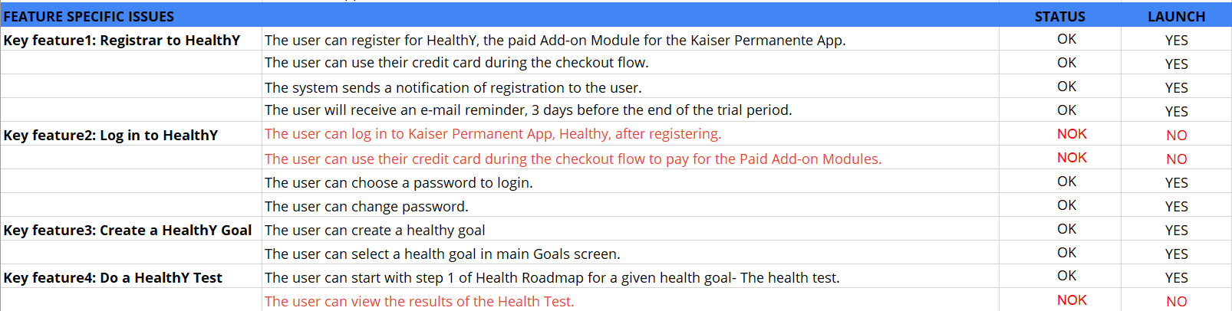
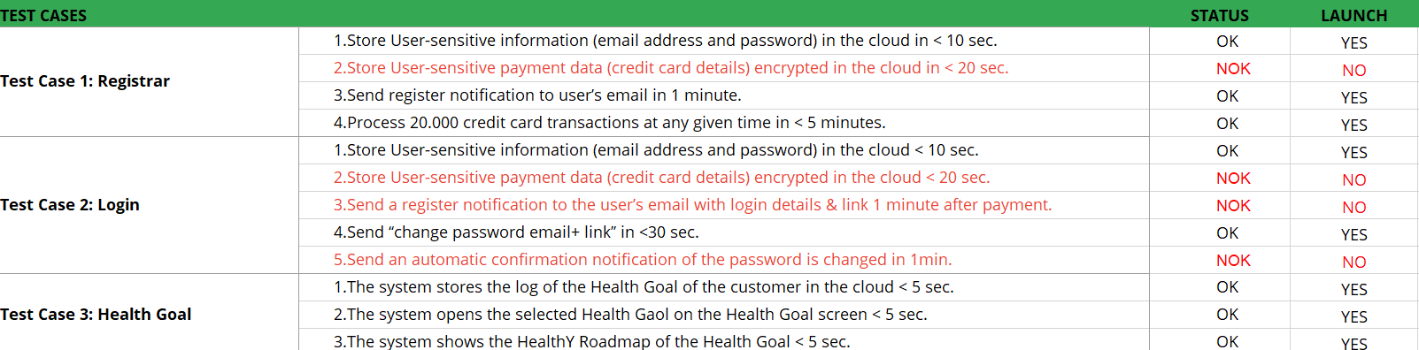
Summary: Issues Key Features
At Risk
Status

Slide 40
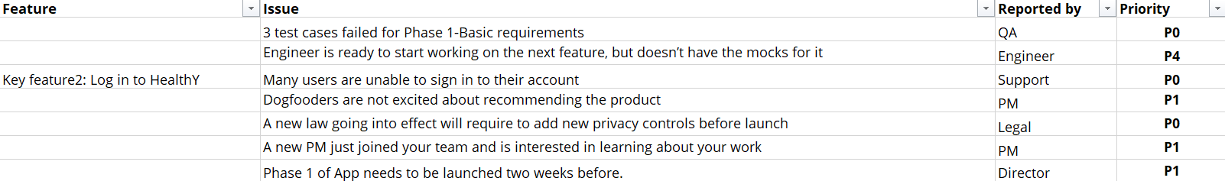
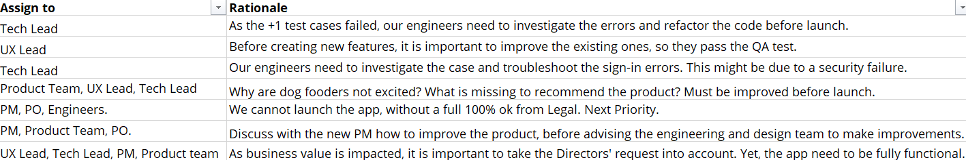
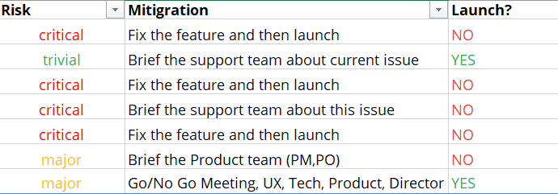
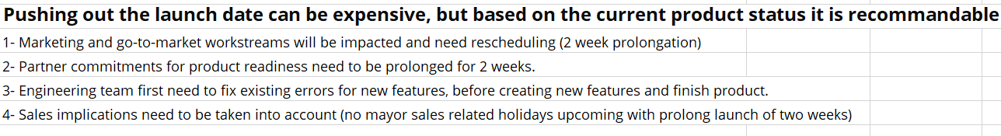
Summary: Risk, Mitigation, Launch
Some Risk
Ready to Launch
At Risk
Status

Slide 41
Launch Recommendation: No Go
At Risk
Based on the outcome of the test plan with our 4 key features, I would recommend
NOT TO LAUNCH the HealthY add-on (Module 0) of the Kaiser Permanente app, yet. Due to the following reasons:
The login feature failed during testing. Also, 1/3 of dog fooders ran into issues. This will create an overload of user support cases and a negative user experience. This is a Must have to launch.
Health Goals can be created, yet still 1/3 of dog fooders ran into issues. This part also needs to be without failure before launch.
The Health Test is created, yet still 1/3 of dog fooders ran into issues. This part needs to be flawless. If not, it will create an overload of user support cases and a negative user experience.
Based on this, I would recommend continuing to improve the basic features until all pass the test plan first. When all four key features have the status
it would be safe to launch Module 0 of HealthY (basic features). Earlier than that, it is wise to keep improving the application to increase a better user experience and decrease the amount of customer support cases, that could have been prevented, by postponing the launch.
Ready to Launch

Slide 42
Invitation: Go / No Go Launch Meeting
To:
Product Manager (me)
Engineering Lead (Mario)
UX Designer (Sara)
Purpose:
Discuss challenges with the features
Identify a path forward
Agenda:
Review current UX design (10 minutes)
Discuss Engineering challenges (10 min)
Brainstorms solutions & path forward (30m)
Review action items and next steps (5 min)
Message:
Hi,
Based on the test plan, I would recommend NOT to launch yet. Instead, we should continue to improve the basic features until all key features pass the test before launch.
We need two more weeks to get the three missing key features with basic requirements fully functional and improved customer experience.
Launching before the basic features are fully operational, will lead to a negative user experience and a high workload of our customer service support team.
Let’s discuss together how to improve the app.
Kind regards,
Diana - Product Manager HealthY.

Slide 43
Responding to Feedback
Your response:
Hi Gregory,
A full 100% production will need an extra two weeks of production and will not be available two weeks earlier. So, we basically have two options.
Option 1: Prioritize a 50% Application, including 2 major features (register, login). The features (Goals, Health Test will not be fully operational).
Option 2: Delay the meeting for two extra weeks for the full production application to be ready. 100% of applications are available.
I believe the 75% application (3 key features fully functioning) will be sufficient for Demo purposes.
Please let me know what you prefer.
Thanks,
Diana- Product Manager HealthY.
Your director:
This all looks really promising! Can we launch two weeks earlier than originally planned?

Slide 44
Thank you
© 2019 Udacity. All rights reserved.
Notes:
[ALL PARTICIPATION]

